Slide 1

Unit-III: Optical Sources, Amplifier and Transmitter

Slide 2
Contents
Optical Sources: Light source materials, LED Structures; Surface and Edge emitters, Quantum efficiency and power, LED Characteristics
Semiconductor Laser Diode, Modes and threshold conditions, External Quantum efficiency, LASER Characteristics
Single mode Laser: VCSEL
Fiber Amplifiers: EDFA, SOA
Block diagram of a Transmitter module

Slide 3
Light Emitting Diode (LED)
Best light source for system requiring bit rates less than 100-200Mb/s and optical power in tens of microwatts
Less complex drive circuitry
No thermal or optical stabilization circuits needed
Fabrication cost is less
Requirement-> High radiance output
-> Fast emission response time
-> High quantum efficiency
Measure of optical power radiated in to a unit solid angle per unit area of emitting surface
Time delay between the application of a current pulse and the onset of optical emission
Fraction of injected electron hole pairs that recombine radiatively

Slide 4
LED Structures
To achieve a high radiance and a high quantum efficiency, LED structure should provide carrier confinement and optical confinement
Carrier confinement: used to achieve high level of radiative recombination in the active region of the device -> yields high quantum efficiency.
Optical confinement: prevents absorption of the emitted radiation by the material surrounding pn junction
Most effective LED structure to achieve these confinement is Double heterostructure or heterojunction (two different alloy layers on each side of active region)
This structure confines both carriers and optical field in central active layer

Slide 5
LED Structures
The bandgap differences of adjacent layers confine the charge carriers
Difference in the indices of refraction of adjoining layers confine the optical field to the central active layer
Dual confinement leads to both high efficiency and high radiance
Other parameters influencing the device performance
Optical absorption in active region
Carrier recombination at the heterostructure interface
Doping concentration of active layer
Injection carrier density
Active layer thickness
Two basic configurations
Surface Emitter
Edge Emitter

Slide 6
LED Structures
Cross sectional drawing of a typical GaAlAs double heterostructure light emitter
Energy band diagram showing the active region, electron and hole barriers that confine the charge carriers to the active layer
Variations in the refractive index

Slide 7
LED Structures- Surface Emitter

Slide 8
LED Structures- Surface Emitter
The plane of the active light emitting region is oriented perpendicularly to the axis of the fiber
The fiber is cemented in the well etched in the substrate to accept the emitted light
Circular active are is 50µm in diameter and 2.5µm in thickness
Emission pattern is essentially isotropic with 120° half power beam width
Isotropic pattern from surface emitter is called as lambertian pattern
Equal brightness from all sides, but power diminishes as cosθ
θ -> angle between the viewing direction and the normal to the surface

Slide 9
LED Structures- Edge Emitter
θ|| ≈ 120°
θ_{Ʇ} ≈ 30°

Slide 10
LED Structures- Edge Emitter
Active junction region is the source of the incoherent light and two guiding layers
Guiding layers both have a refractive index lower than that of active region but higher than index of surrounding material
Contact stripes for the edge emitter 50 – 70 µm wide and length of the active regions range from 100 to 150 µm
Emission pattern is more directional than surface emitter
In plane parallel to junction, the emitted beam is lambertian with a half power width of θ|| ≈ 120°
In the plane perpendicular to the junction, the half power θ_{Ʇ} is 25-35°

Slide 11
Light Source Materials
In direct bandgap semiconductor electrons and holes can recombine directly across bandgap without needing a third particle to conserve momentum
Radiative recombination sufficiently high to produce an adequate level of optical emission
Direct bandgap compounds are made from III-V materials
III element- Al, Ga, In
V element- P, As, Sb
Principal material used is the ternary alloy Ga_{1-x}Al_{x}As
The ratio ‘x’ of AlAs to GaAs determines the bandgap of the alloy and wavelength of the peak emitted radiation.
The value of x for the active area material- 800-850nm

Slide 12
Light Source Materials

Slide 13
Light Source Materials
For longer wavelengths – Quaternary alloy-> In_{1-x}Ga_{x}As_{y}P_{1-y}
Very close match between the crystal lattice parameters of the two adjoining heterojunctions is required to reduce interfacial defects and to minimize strains in the device as temperature varies
The fundamental quantum mechanical relationship between energy E and frequency v is given as
Wavelength in micrometers is given as

Slide 14
Light Source Materials
In the ternary alloy GaAlAs the bandgap energy E_{g} and the crystal lattice spacing a₀ are determined by dashed line as in figure
The energy bandgap for values of x from 0 to 0.37 is given as
For In_{1-x}Ga_{x}As_{y}P_{1-y} bandgap is given as

Slide 15
Light Source Materials
Typical Characteristics of surface and Edge emitting LEDs

Slide 16
Quantum Efficiency and LED Power
Minority carriers are created by carrier injection at device contacts
When carrier injection stops, the carrier density returns to equilibrium
The excess carrier density decays exponentially with time as
n0- initial injected excess electron density
τ – Carrier life time.
Excess carriers recombine radiatively or non radiatively
Radiative recombination: photon of energy hγ is emitted
Non radiative recombination: It includes optical absorption in active region, carrier recombination at heterojunction and auger process (energy released during recombination is transferred to another carrier in the form of kinetic energy)

Slide 17
Quantum Efficiency and LED Power
Total rate of carrier generation = externally supplied rate + thermally generated rate
The rate equation for carrier recombination in an LED is given as
J/qd -> externally supplied rate
n/τ -> thermal generation rate
The equilibrium condition is given by setting equ (1) to zero. Thus
………………….. (1)
………………….. (2)

Slide 18
Quantum Efficiency and LED Power
The internal quantum efficiency in the active region is the fraction of electron hole pairs that recombine radiatively
It is the ration of radiative recombination to total recombination
R_{r}-> Radiative recombination
R_{nr}-> Non Radiative recombination
Radiative lifetime is
Non radiative lifetime is
Internal quantum efficiency is given as
………………….. (3)
………… (4)

Slide 19
Quantum Efficiency and LED Power
Bulk recombination lifetime is given as
R_{r} and R_{nr} is similar in magnitude, so the internal quantum efficiency is 50% for simple homojunction LEDs
Heterojunction-> 60-80%
Total number of recombination per second is
Sub (6) in (3) --->
Optical power generated is
………………….. (5)
…………(6)
……..………(7)

Slide 20
Quantum Efficiency and LED Power
Emitted power-> need to consider external quantum efficiency
It is defined as ratio of the photons emitted from the LED to the number of internally generated photons
It is given as
T(φ) - > Fresnel transmissivity or Fresnel transmission coefficient and depends on incidence angle φ
……..………(8)
……..………(9)

Slide 21
Quantum Efficiency and LED Power
When n1 = n, then and external quantum efiiciency is given as
The optical power emitted from LED is
……..………(10)
……..………(11)

Slide 22
LED Characteristics
SLED radiates significantly more optical power
SLED and ELED are linear at moderate drive currents
SLED gives high output power for more forward current
Low spectral width allows increased data rate.
η_{int} decreases with increasing temperature, thus light output decreases
ELED has high temp dependence than SLED

Slide 23
Numericals

Slide 24
Numericals

Slide 25
Numericals

Slide 26
LASER DIODE
LASER is an acronym for “Light Amplification by Stimulated Emission of Radiation”.
•Coherent light
•Narrow beam width
•Lasers can produce high output power. In fiber optic communication applications, semiconductor lasers power more than 20 milliwatts are available.
•As Laser light is Coherent, a high percentage (50% to 80%) can be coupled into the fiber core.

Slide 27
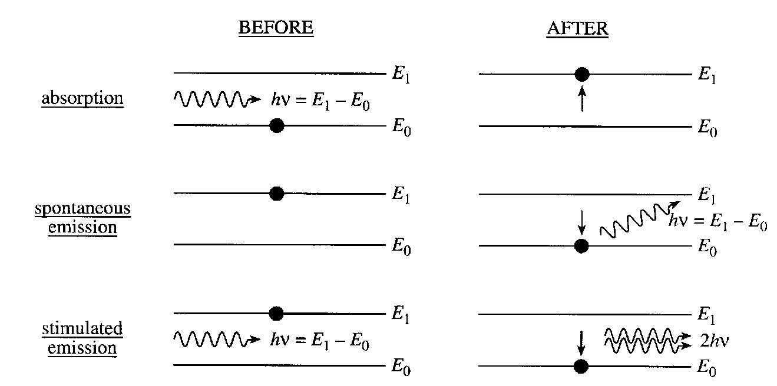
LASER : Basic Operation Fundamental Lasing Operation
Absorption
Spontaneous emission
Stimulated emission
Energy absorbed from the incoming photon
Random release of energy
Coherent release of energy

Slide 28
LASER : Basic Operation Fundamental Lasing Operation
At thermal equilibrium : Photon absorption and emission processes take place side by side, but because N1>N2 ; absorption dominates.
•Laser operation requires stimulated emission exclusively and to achieve this, majority of atoms should be at higher energy level than at lower level.
•Energy is to be supplied to the laser medium to raise atoms from the lower level to the excited level
•The process by which atoms are raised from the lower level to the upper level is called pumping.

Slide 29
LASER : Basic Operation Fundamental Lasing Operation
In Stimulated Emission incident and stimulated photons will have
•Identical energy → Identical wavelength → Narrow linewidth
• Narrow beam width
•Coherence and Identical polarization

Slide 30
CHARACTERISTIC OF LASER DIODE
Suitable for system Bandwidth >200 MHz
Response time less than 1 ns
Optical Bandwidth of 2 nm or less
Cable of coupling several tens of milliwatts of Luminescent Power
Can couple with optical fiber with small cores and small mode field diameters.

Slide 31
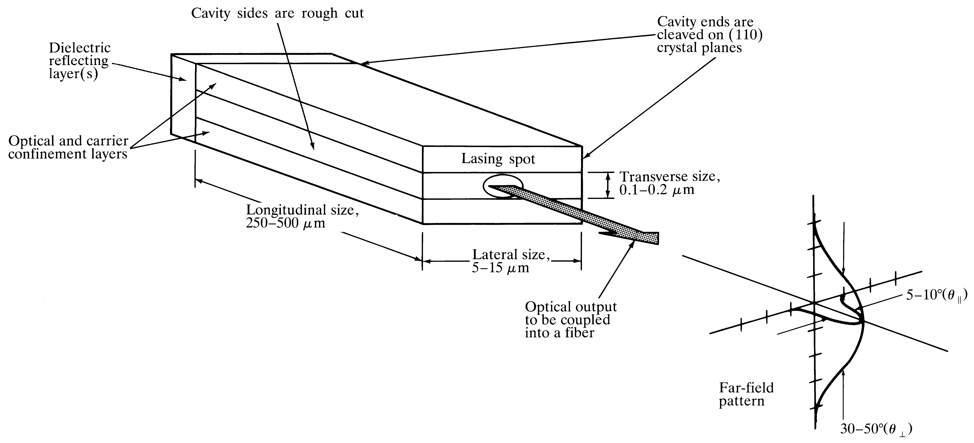
LASER DIODE
Laser diode is an improved LED, in the sense that uses stimulated emission in semiconductor from optical transitions between distribution energy states of the valence and conduction bands with optical resonator structure such as Fabry-Perot resonator with both optical and carrier confinements.
Optical Fiber communications, 3rd ed.,G.Keiser,McGrawHill, 2000

Slide 32
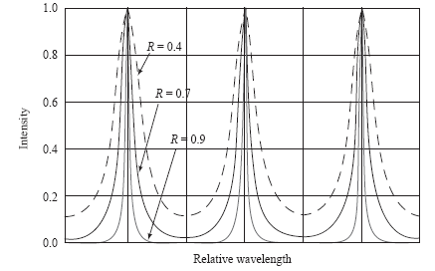
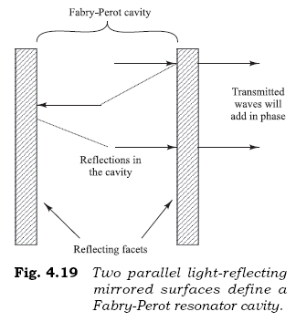
Fabry-Perot Lasing Cavity
A Fabry-Perot cavity consists of two flat, partially reflecting mirrors that establish a strong longitudinal optical oscillator feedback mechanism, thereby creating a light-emitting function.
The distance between the adjacent peaks of the resonant wavelengths in a Fabry-Perot cavity is the modal separation. If L is the distance between the reflecting mirrors & the refractive index is n, then at a peak wavelength λ the MS is given by

Slide 33
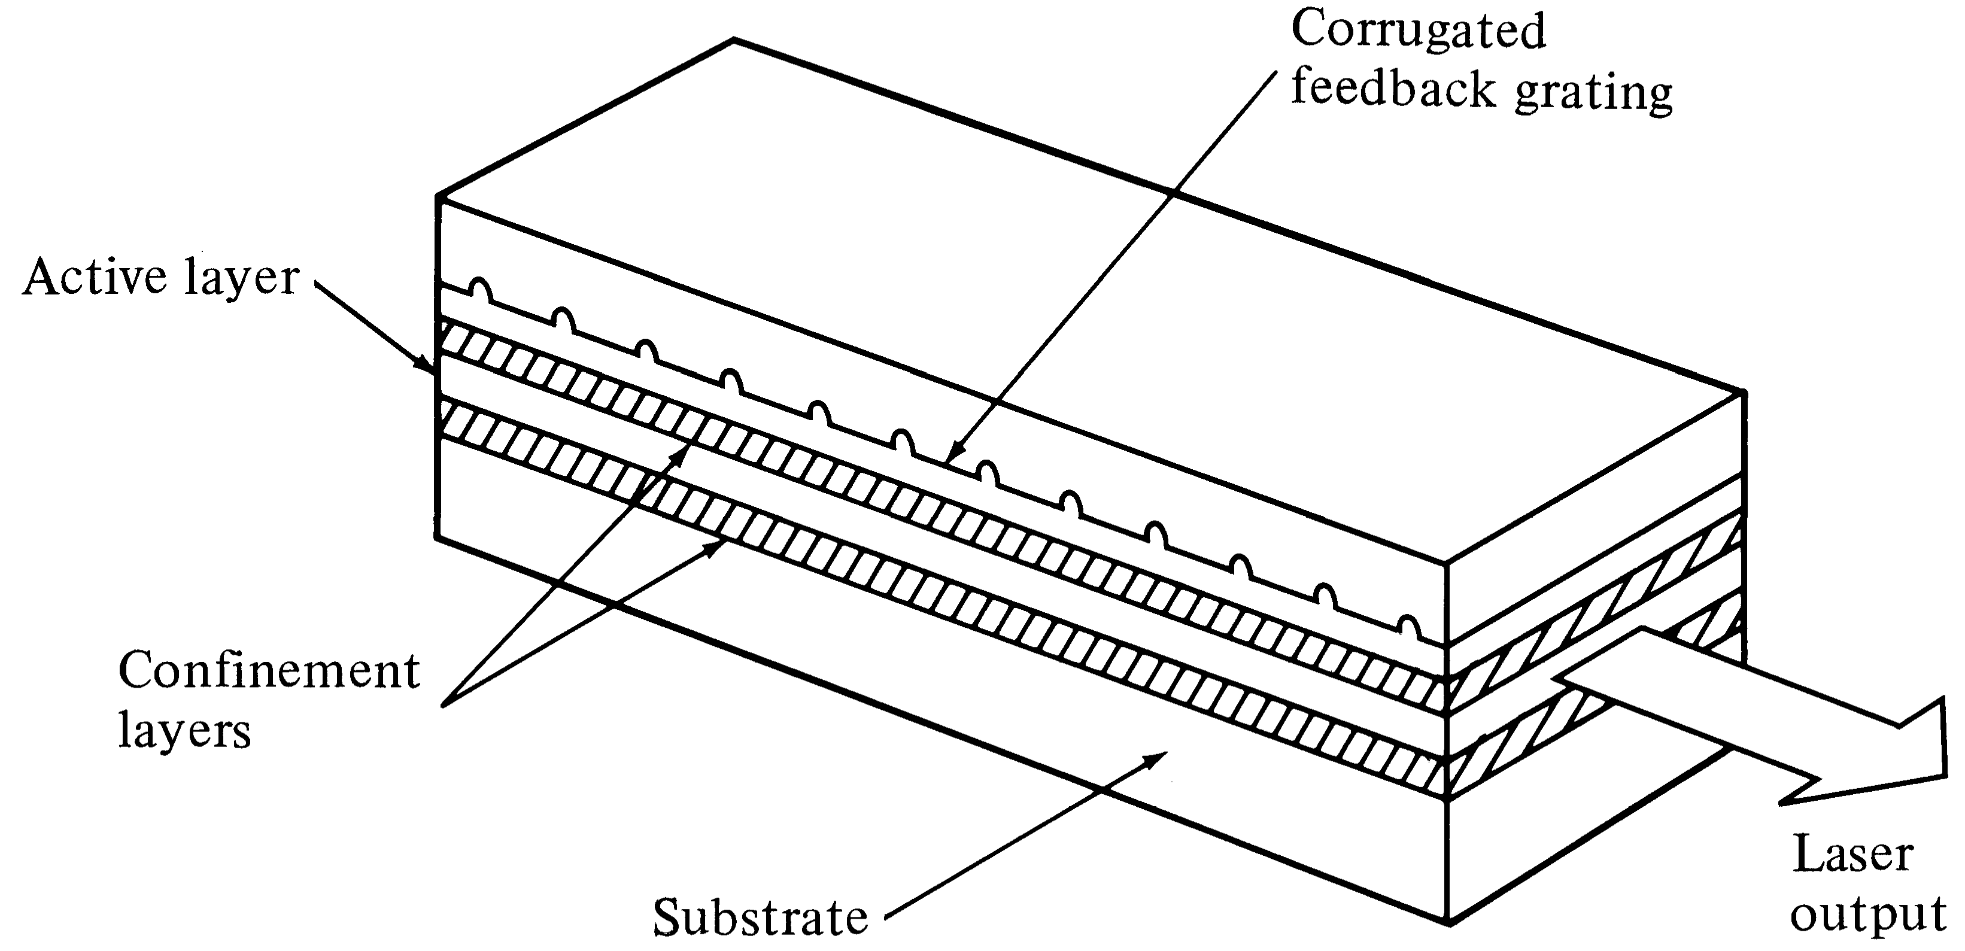
DFB(Distributed FeedBack) Lasers
In DFB lasers, the optical resonator structure is due to the incorporation of Bragg grating or periodic variations of the refractive index into multilayer structure along the length of the diode.
The optical feedback is provided by fiber Bragg Gratings
€ Only one wavelength get positive feedback
Optical Fiber communications, 3rd ed.,G.Keiser,McGrawHill, 2000

Slide 34

Laser Operation & Lasing Condition
To determine the lasing condition and resonant frequencies, we should focus on the optical wave propagation along the longitudinal direction, z-axis. The optical field intensity, I, can be written as:
Lasing is the condition at which light amplification becomes possible by virtue of population inversion. Then, stimulated emission rate into a given EM mode is proportional to the intensity of the optical radiation in that mode. In this case, the loss and gain of the optical field in the optical path determine the lasing condition.
The radiation intensity of a photon at energy varies exponentially with a distance z amplified by factor g, and attenuated by factor according to the following relationship:
$$hν$$

Slide 35
[4-20]
Z=0
Z=L
[4-21]
Lasing Conditions:
[4-22]

Slide 36
THRESHOLD GAIN & CURRENT DENSITY
LASER starts to Lase only if g>gth
For laser structure with strong carrier confinement, the threshold current
Density for stimulated emission can be well approximated by:

Slide 37
LASER RESONANT FREQUENCIES
Lasing condition, namely eq. [4-22]:
Assuming the resonant frequency of the mth mode is:

Slide 38
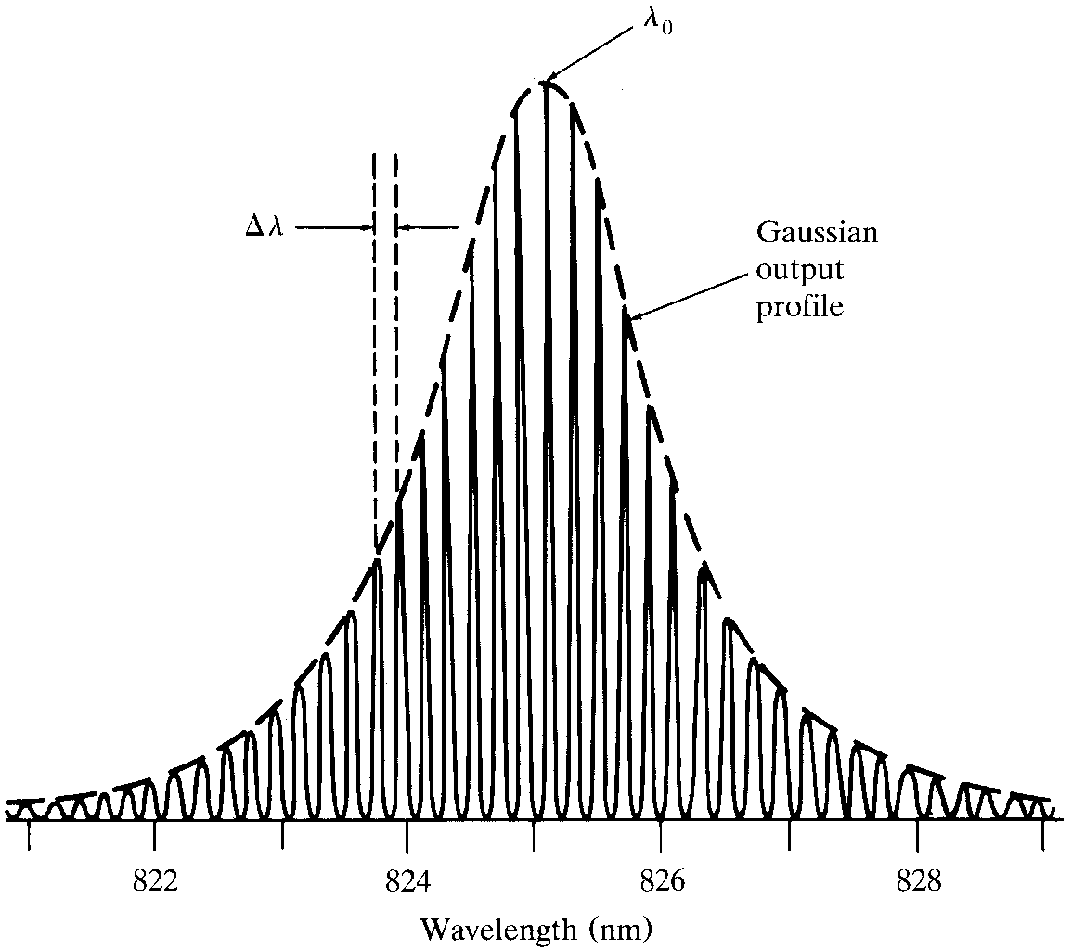
Spectrum from a Laser Diode

Slide 39
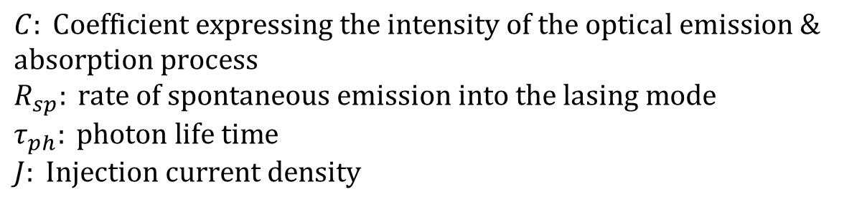
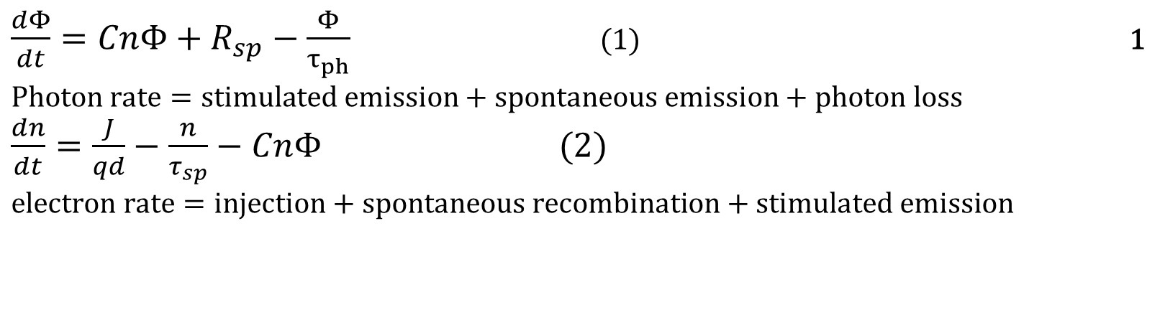
LASER RATE EQUATIONS
Rate equations relate the optical output power, or no of photons per unit volume, Φ , to the diode drive current or # of injected electrons per unit volume, n. For active (carrier confinement) region of depth d, the rate equations are:
$\frac{dΦ}{dt}=CnΦ+R_{sp}−\frac{Φ}{τ_{ph}}$ (1) 1 $$\text{Photon} \text{rate}=\text{stimulated} \text{emission}+\text{spontaneous} \text{emission}+\text{photon} \text{loss}$$ $\frac{dn}{dt}=\frac{J}{qd}−\frac{n}{τ_{sp}}−CnΦ (2)$ $$\text{electron} \text{rate}=\text{injection}+\text{spontaneous} \text{recombination}+\text{stimulated} \text{emission}$$
$$C: \text{Coefficient} \text{expressing} \text{the} \text{intensity} \text{of} \text{the} \text{optical} \text{emission}\text{ \& }\text{absorption} \text{process} \\ R_{sp}: \text{rate} \text{of} \text{spontaneous} \text{emission} \text{into} \text{the} \text{lasing} \text{mode} \\ τ_{ph}: \text{photon} \text{life} \text{time} \\ J: \text{Injection} \text{current} \text{density}$$

Slide 40
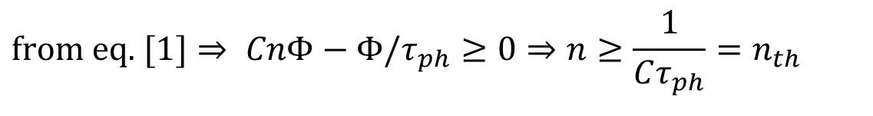
THRESHOLD CURRENT DENSITY & EXCESS ELECTRON DENSITY
At the threshold of lasing:
The threshold current needed to maintain a steady state threshold concentration of the excess electron, is found from electron rate equation under steady state condition dn/dt=0 when the laser is just about to lase:
$$\text{from} \text{eq}\text{. }[1]⇒ CnΦ−Φ/τ_{ph}≥0⇒n≥\frac{1}{Cτ_{ph}}=n_{th}$$

Slide 41
Laser operation beyond the threshold
The solution of the rate equations [4-25] gives the steady state photon density, resulting from stimulated emission and spontaneous emission as follows:

Slide 42
External quantum efficiency
Number of photons emitted per radiative electron-hole pair recombination above threshold, gives us the external quantum efficiency.
Note that:

Slide 43
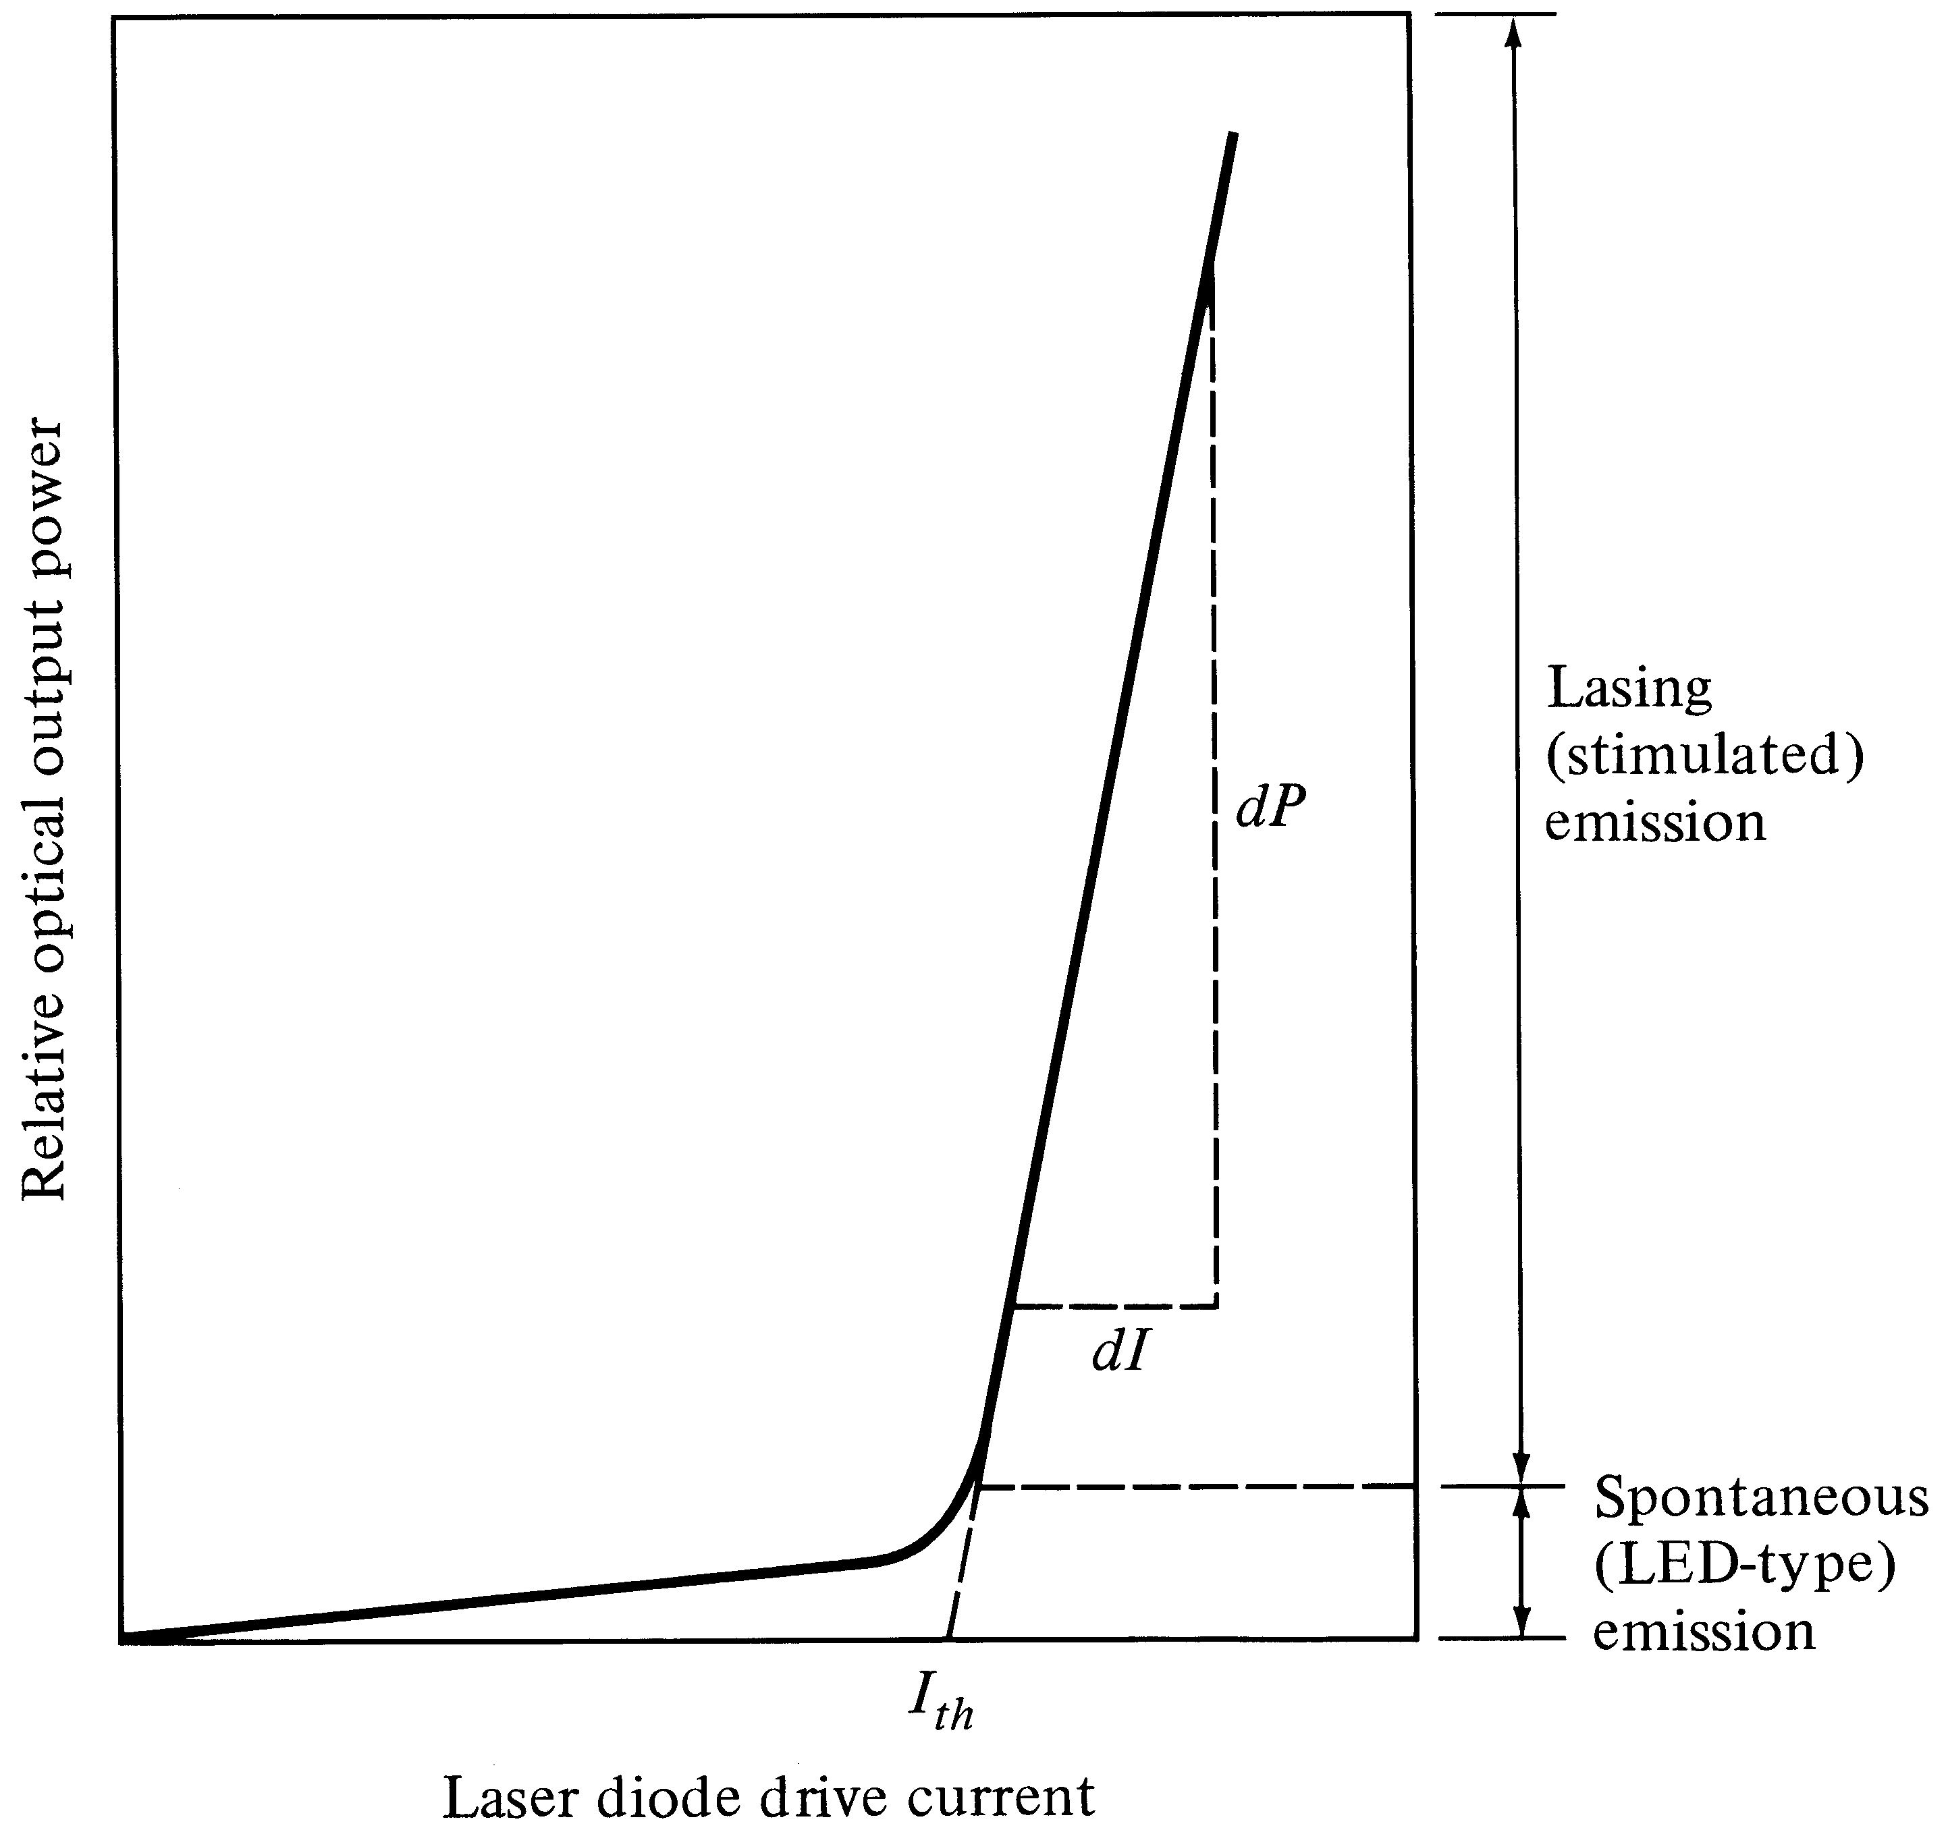
LASER P-I CHARACTERISTICS
External Efficiency
Depends on the slope
Threshold Current

Slide 44
Vertical Cavity Surface Emitting Laser- VCSEL
Vertical cavity means the structure (cavity) providing laser feedback is arrange in the vertical direction
Surface emitting means the laser beam is emitted perpendicular to the wafer
Semiconductor heterostructure forms an active region
Several quantum wells are made within this active region to enhance light gain
This region is placed between Bragg reflectors- the stacks of layers with alternate high and low refractive index material
Each layer is λ/4 thick and made from GaAs (n=3.6) and AlAs (n=2.9)
These layer work like high reflective mirror providing positive feedback

Slide 45
Vertical Cavity Surface Emitting Laser- VCSEL

Slide 46
Vertical Cavity Surface Emitting Laser- VCSEL
Advantages
Size of the resonant cavity is very small resulting in huge spacing between two adjacent longitudinal modes
Only one mode can be within gain curve
Operates in single mode regime
Very small dimensions (cavity and diameter of active region is about 1 to 5µm and thickness is 25nm)
Can fabricate many diodes on one substrate
Low power consumption and high switching speed
High current density at low current value
Short lifetime leading to high modulation bandwidth

Slide 47
Vertical Cavity Surface Emitting Laser- VCSEL
VCSEL diode radiates a circular output beam in contrast to that radiated by edge emitting lasers
Fabrication technology is very similar to that for electronic chips
Disadvantages
Commercially available in the wavelength range no longer than 850nm
Trend in VCSEL is to extend their operating wavelength to 1300nm and 1550nm

Slide 48
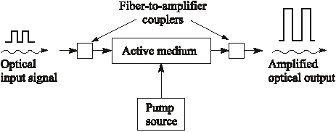
Optical Amplifier
All Optical amplifiers increase the power level of incident light through a stimulated emission or an optical power transfer process.
Fig.: Generic optical amplifier

Slide 49
Optical Amplifier
The device absorbs energy supplied from a external source called pump
The pump supplies energy to electrons in an active medium which raises them to higher energy levels to produce population inversion
An incoming signal photon will trigger these excited electrons to drop to lower levels through a stimulated emission process and emits photons of equal energy. The result is an amplified optical signal

Slide 50
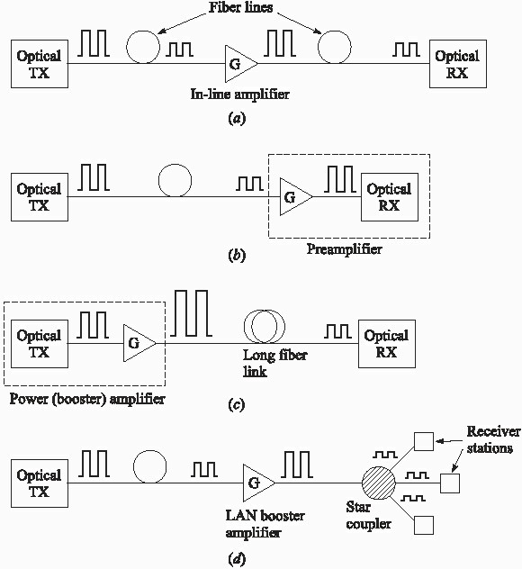
DIFFERENT AMPLIFIER CONFIGURATION
Power amplifier
In-line amplifier
Preamplifier

Slide 51
In-line optical amplifiers
In a single mode link the effects of fiber dispersion is small.
In such a link complete regeneration of the signal is not necessary and simple amplification of the optical signal is sufficient.
Thus, an in-line amplifier can be used to compensate for transmission Loss and increase the distance between regenerative repeaters.
Pre-amplifier
It is a front end amplifier for an optical receiver.
A weak optical signal is amplified before photodetection to increase signal to noise ratio.
Compared with other front-end devices such as APD or heterodyne detectors, an optical pre-amplifier provides a large gain factor and broader bandwidth.
Power Amplifier
Also called booster amplifier includes placing the device immediately after an optical transmitter to boost the transmitted power.
This increases the transmission distance by I0-1OOkm and compensate for coupler insertion Loss and power splitting Loss.

Slide 52
Optical Amplifiers
Two main classes of optical amplifiers include:
Semiconductor Optical Amplifiers (SOA) Doped Fiber Amplifiers (DFA)

Slide 53
Semiconductor Optical Amplifiers
There are two types of SOAs:
--- Fabry- Perot amplifiers (FPA)
When the light enters FPA it gets amplified as it reflects back and forth between the mirrors until emitted at a higher intensity.
It is sensitive to temperature and input optical frequency.
---Non-resonant traveling-wave amplifiers (TWA)
It is the same as FPA except that the end facets are either antireflection coated or cleaved at an angle so that internal reflection does not take place and the input signal gets amplified only once during a single pass through the device. They widely used because they have a large optical bandwidth, and low polarization sensitivity.

Slide 54
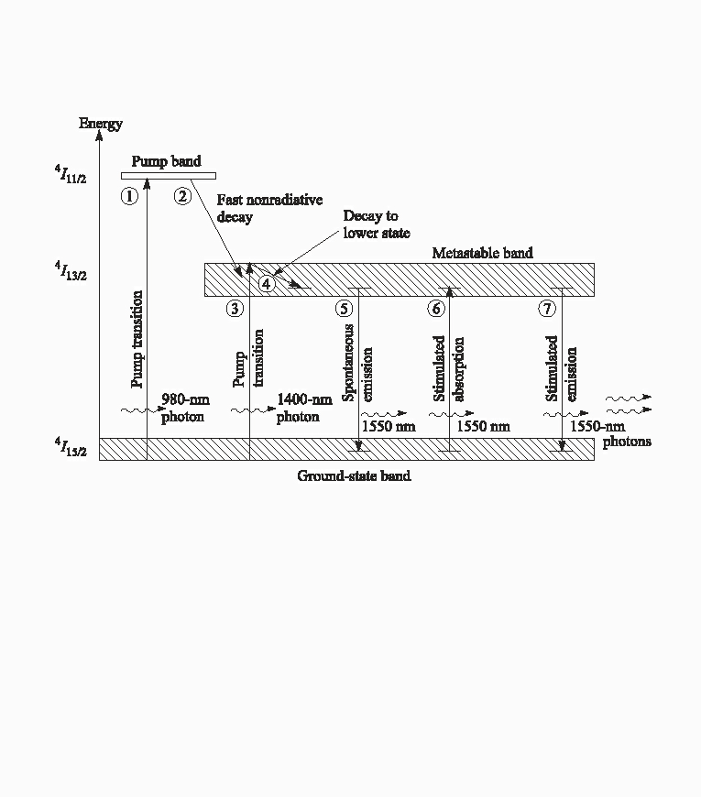
ERBIUM DOPED FIBER AMPLIFIER(EDFA)
Silica fiber is doped with Erbium .
Fig. : Erbium energy-level diagram

Slide 55
EDFA AMPLIFICATION MECHANISM
Two principal levels
Metastable State
Pump Level
The pump band exists at 1.27 eV separation from bottom ground state. The energy corresponds to 980 nm wavelength
The top metastable state is separated from bottom ground state by 0.841 eV. This energy corresponds to 1480nm wavelength
The bottom metastable state is separated from bottom ground state by 0.814 eV This energy corresponds to 1530 nm wavelength
The bottom metastable state is separated from top ground state by 0.775 eV This energy corresponds to I600nm wavelength.

Slide 56
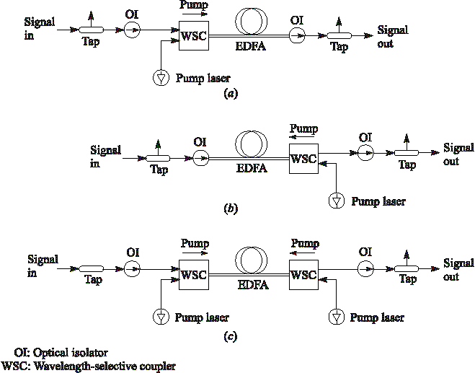
EDFA Configurations
Co-Directional Pumping
Pump light injected in same direction as signal flow
Better noise performance
Counter directional pumping
Pump Light injected in opposite direction of signal flow
High Gain
Dual Pumping
High Gain

Slide 57
EDFA Power-Conversion Efficiency (PCE) and Gain
The input and output power of an EDFA can be expressed:
λ
λ
Maximum output signal power depends on wavelength ratio
of the pump to the signal. Pumping works only
When λp< λs and for appropriate gain P_{s,in} << P_{p,in}
^{P}s,out ^{≤ P}s,in ⁺
p
P
p,in
s
The Power Conversion Efficiency (PCE) is defined as (always less than unity)
It is equal to 1 when all
P − P P
λ
_{PCE =} s,out s,in ≈ s,out ≤ p
≤ 1
pump photons are converted to signal photons
^{P}p,in
^{P}p,in
λ_{s}

Slide 58
OPTICAL AMPLIFIER
We can also write the amplifier gain as:
λ _{p}
λ_{s}
^{P}s,out
^{P}p,in
G = ≤ 1 +
When input signal power is very large
^{P}s,in
^{P}s,in
i.e.
^{P}s,in ^{>> (λ}p ^{/ λ}s ^{)P}p,in
then the maximum G is unity
In order to achieve a specific maximum gain G, the input signal power can NOT exceed a value given by
λ _{p}
λ
^{P}p,in
P
≤ s
s,in
G − 1

Slide 59
EDFA Power-Conversion Efficiency (PCE) and Gain
The maximum gain in a 3 level laser medium of length L can also be given as
follow (in addition to pump power, the gain depends on the fiber length)
G_{max} = exp(Nσ_{e} L)
where N is the rare-earth element concentration and σe is the signal- emission cross section.
Therefore the maximum gain or power will be defined as:
⎧⎪
λ
p ^{P}p,in ⎫⎪
G ≤ min⎨exp (ρσ L)
,1 +
⎬
⎪⎩
e
λ P
⎪⎭
s
s,in
⎧
λ _{p}
⎫
P ≤ min ⎨P_{s,in} exp (ρσ L), P
P
s,out
e
s,in
p,in ⎬
⎩
λ
⎭
s

Slide 60
Transmitter Module
Transmitter is the unit responsible for converting an electrical information signal in to an optical one
It includes
Light source
Coupling optics
Signalling circuit
Power control circuit
Data from outside electronic circuits enter this module along with a clock signal
A special unit converts the data in to a format suitable to control a laser diode.

Slide 61
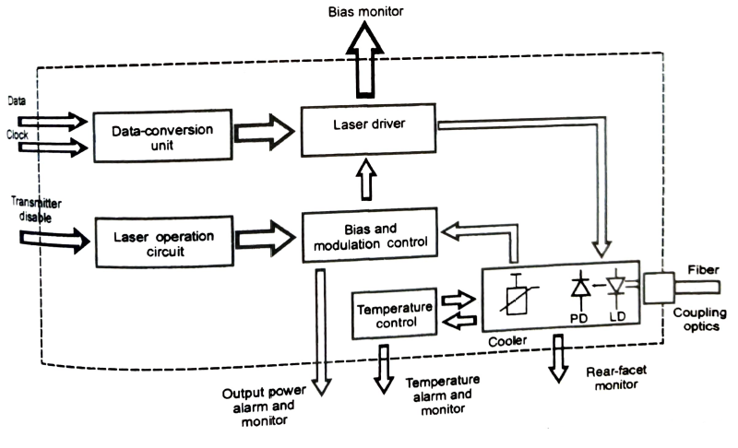
Transmitter Module

Slide 62
Transmitter Module
Laser driver changes the forward current to modulate the output light radiated by a laser diode
Data conversion unit
Performs encoding, parallel to serial conversion and reshaping the electric format of the data
Encoding means representing data in a physical format (pulses)
Different line codes used are NRZ, Manchester code, Return to zero etc.
NRZ- convenient but has poor transmission capability. Transmitter and receiver consumes more electric power because of dc power component

Slide 63
Transmitter Module
Manchester- transition occur in the middle of clock pulse. No dc component and signal itself carries synchronization information. But it needs twice the bandwidth for transmission.

Slide 64
Transmitter Module
Clock Signal
Manchester
RZ
NRZ

Slide 65
Transmitter Module
Data enter the fiber optic in any one of the code , but output of the transmitter represents logic 1 as flash of light and 0 as period of darkness.
In parallel to serial conversion, a multiplexer (parallel in serial out) is used to convert data in to serial format.
For reshaping the electric format, a comparator or the buffer can be used
Comparator compares two signals- data and complementary signal
If the complementary is higher, output becomes zero
If data is higher, output becomes equal to V_{cc}

Slide 66
Transmitter Module
Comparator produces high or low voltage in response to input logic 1 or 0
This circuit has high input impedance which makes it compatible with the multiplexer
Buffer is a device that isolates the input from the output and amplifies the current while transferring the logic signal from the input to the output unchanged
Fiber optic transmitter usually utilize emitter coupled logic (ECL)
ECL include high speed, low noise and the ability to drive low impendence circuits
Other logic used- TTL, CMOS

Slide 67
Transmitter Module
Laser Driver
Laser driver convert outside voltage in to current needed to drive the laser
Driving current has to bias a laser diode to provide a bias current
Bias current has to be very stable with threshold current else error occurs
Main factor changing threshold current is temperature
The feedback signal from the temperature sensor that reaches the laser driver through bias control circuit closes the control loop

Slide 68
Transmitter Module
In the figure, current flowing through the resistor (R) depends only on the input voltage and does not depend on load resistance
When temperature varies, the feedback signal obtained from a photodiode helps to stabilize the average output power by changing the bias current
Modulation Circuit
Modulation is controlled by changing the driving current from the bias level to maximum
When data are represented by a voltage greater than V_{BB}, Q₁ conducts the current and hence laser diode is off
When data are represented by a voltage less than V_{BB}, Q₂ conducts the current and hence laser diode is on

Slide 69
Transmitter Module
V_{BB} at ±400mV and proper design of Q₃ keep transistor Q₁ and Q₂ from saturation
Signal as small as 800mV switches the gate from logic 1 to 0
Switching between transistors Q₁ and Q₂ occurs very fast
Q₃ can be controlled by V_{drive}
This is necessary because stabilizing the bias current is not enough, as this characteristics actually represents output power only when no.of 1’s and 0’s are equal
This is referred as 50% duty cycle

Slide 70
Transmitter Module
Another important concern is control of extinction or on-off ratio
It is the ration of max to min light power representing logic 1 and logic 0
It is controlled by varying current and can be done automatically
Given circuit
Stabilizes the average power by changing the bias current to compensate for aging and temperature induced variations
Compensates for fluctuations in output light power caused by variations of the duty cycle when driving changes

Slide 71
Transmitter Module
Controlling and Monitoring circuits
Transmitter disable signal allow the user to shut down the transmitter while keeping the module in the stand by mode
This can be done by placing high voltage signal at the base of transistor Q₁
Voltage across R₁ and R₂ allow the user to receive the bias and modulation monitoring signals
Photocurrent produced by PD shows whether LD is working
Monitoring signal enables the user to troubleshoot the transmitter
Signal from temperature sensor helps to monitor entire ambient temperature
Output also provide alarm to signal if any monitored parameters deviate

Slide 72
REFERENCES
Keiser G, “Optical Fiber Communication ”, 5th Edition
Djafar.K. Mynbaev and Lowell and Scheiner, “Fiber Optic Communication Technology”

